Slide 1

Professional Program Management System
Team Members: Joana Fraga, Jose Casanova Product Owner: Nagarajan Prabakar
Instructor: Masoud Sadjadi School of Computing and Information Sciences Florida International University
Final Presentation
2017
Notes:
7 seconds.( I will select 2 best slides (i will give them extra points and students will present for CIS committee)
Greet your audience, thank them for attending your presentation, introduce yourself, introduce your project, introduce your team members, and quickly indicate what each of you did in a high-level manner, and put more emphasis on your part/contribution.

Slide 2
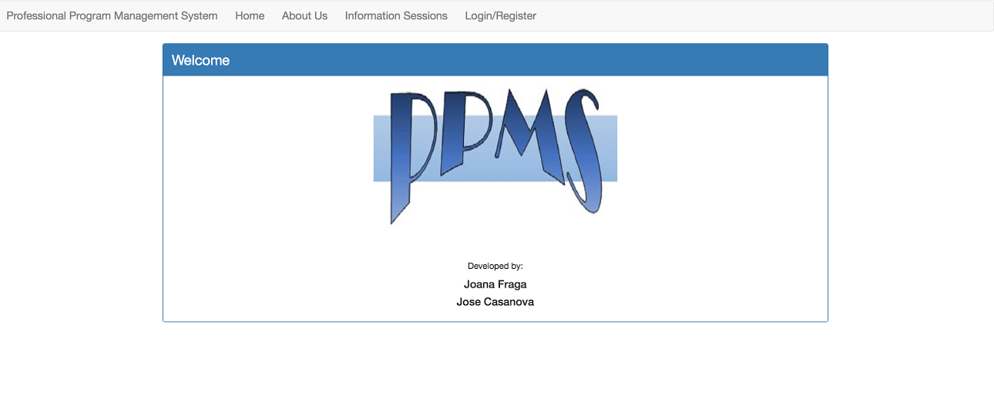
Project definition
Provide a web portal with specific purposes to FIU students taking specialized, odd-hour courses
Provide the ability for administrators to give access to certain features of the portal to users based on type
Notes:
10 seconds.
Introduce the problem that the whole project (in all versions) tackles with GIF or screenshot.

Slide 3
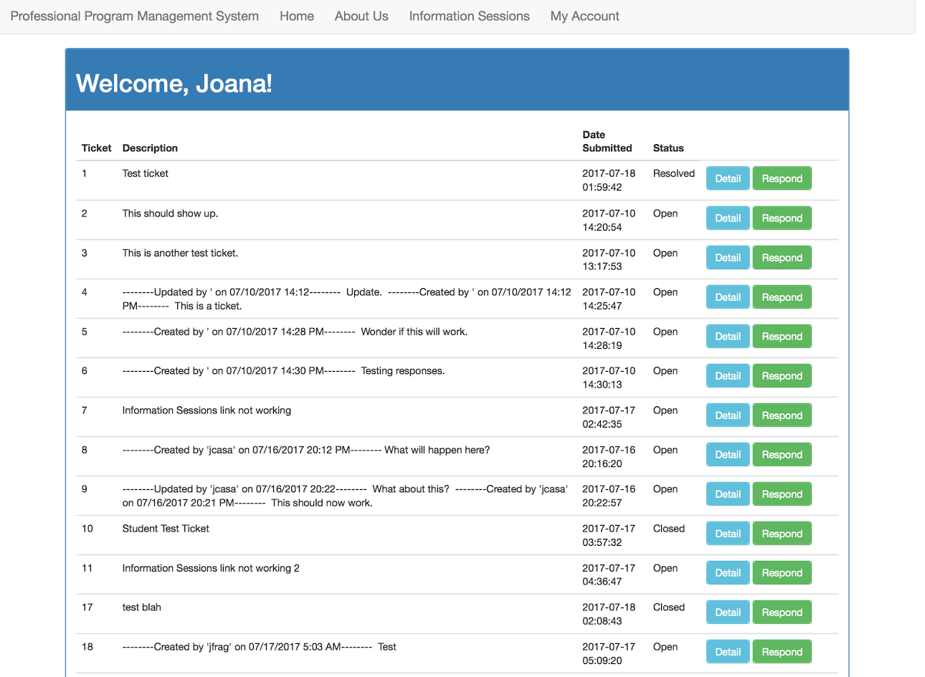
Project definition
Allow potential and existing students alike to learn about the program and view times for info sessions.
Give students the ability to express their concerns through a ticketing system with immediate notification to administrators
Notes:
20 seconds.
Introduce the problem that the your project (in new version) tackles with GIF or screenshot.

Slide 4
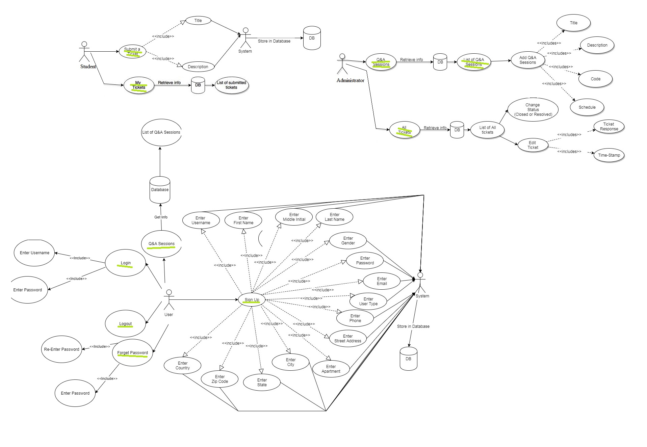
Requirements: Use Case
Notes:
5 seconds
Show the Use Case Diagram for the whole project. Highlight your use cases.

Slide 5
System Design: Architecture
Web portal maintained on a DigitalOcean Ubuntu server
Server API is apache2handler v. 2.4.7
Database maintained on-server through MySQL version 14.14 distribution 5.5.14
Uses PHP v. 5.5.9
Angular 2
Notes:
20 seconds
System design: Highlight the parts that you contributed to them.
1. System decomposition; identify the architecture patterns used
2. System deployment – h/w and s/w requirements

Slide 6
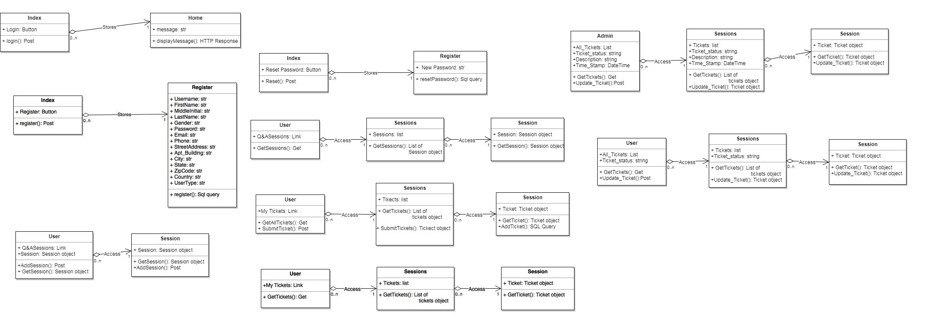
Minimal Class Diagram
Notes:
10 seconds.Minimal class diagram. Highlight the classes that you created/modified
Identify the design patterns used (one or more slides).

Slide 7
User Stories
Creating and viewing tickets.
Resetting a password
Logging in and out
Registering
Viewing current schedule and adding new courses.
Notes:
5 seconds.
List the user stories that you worked on them.(put in order of importance). Stay focused on the parts that you have been working.

Slide 8
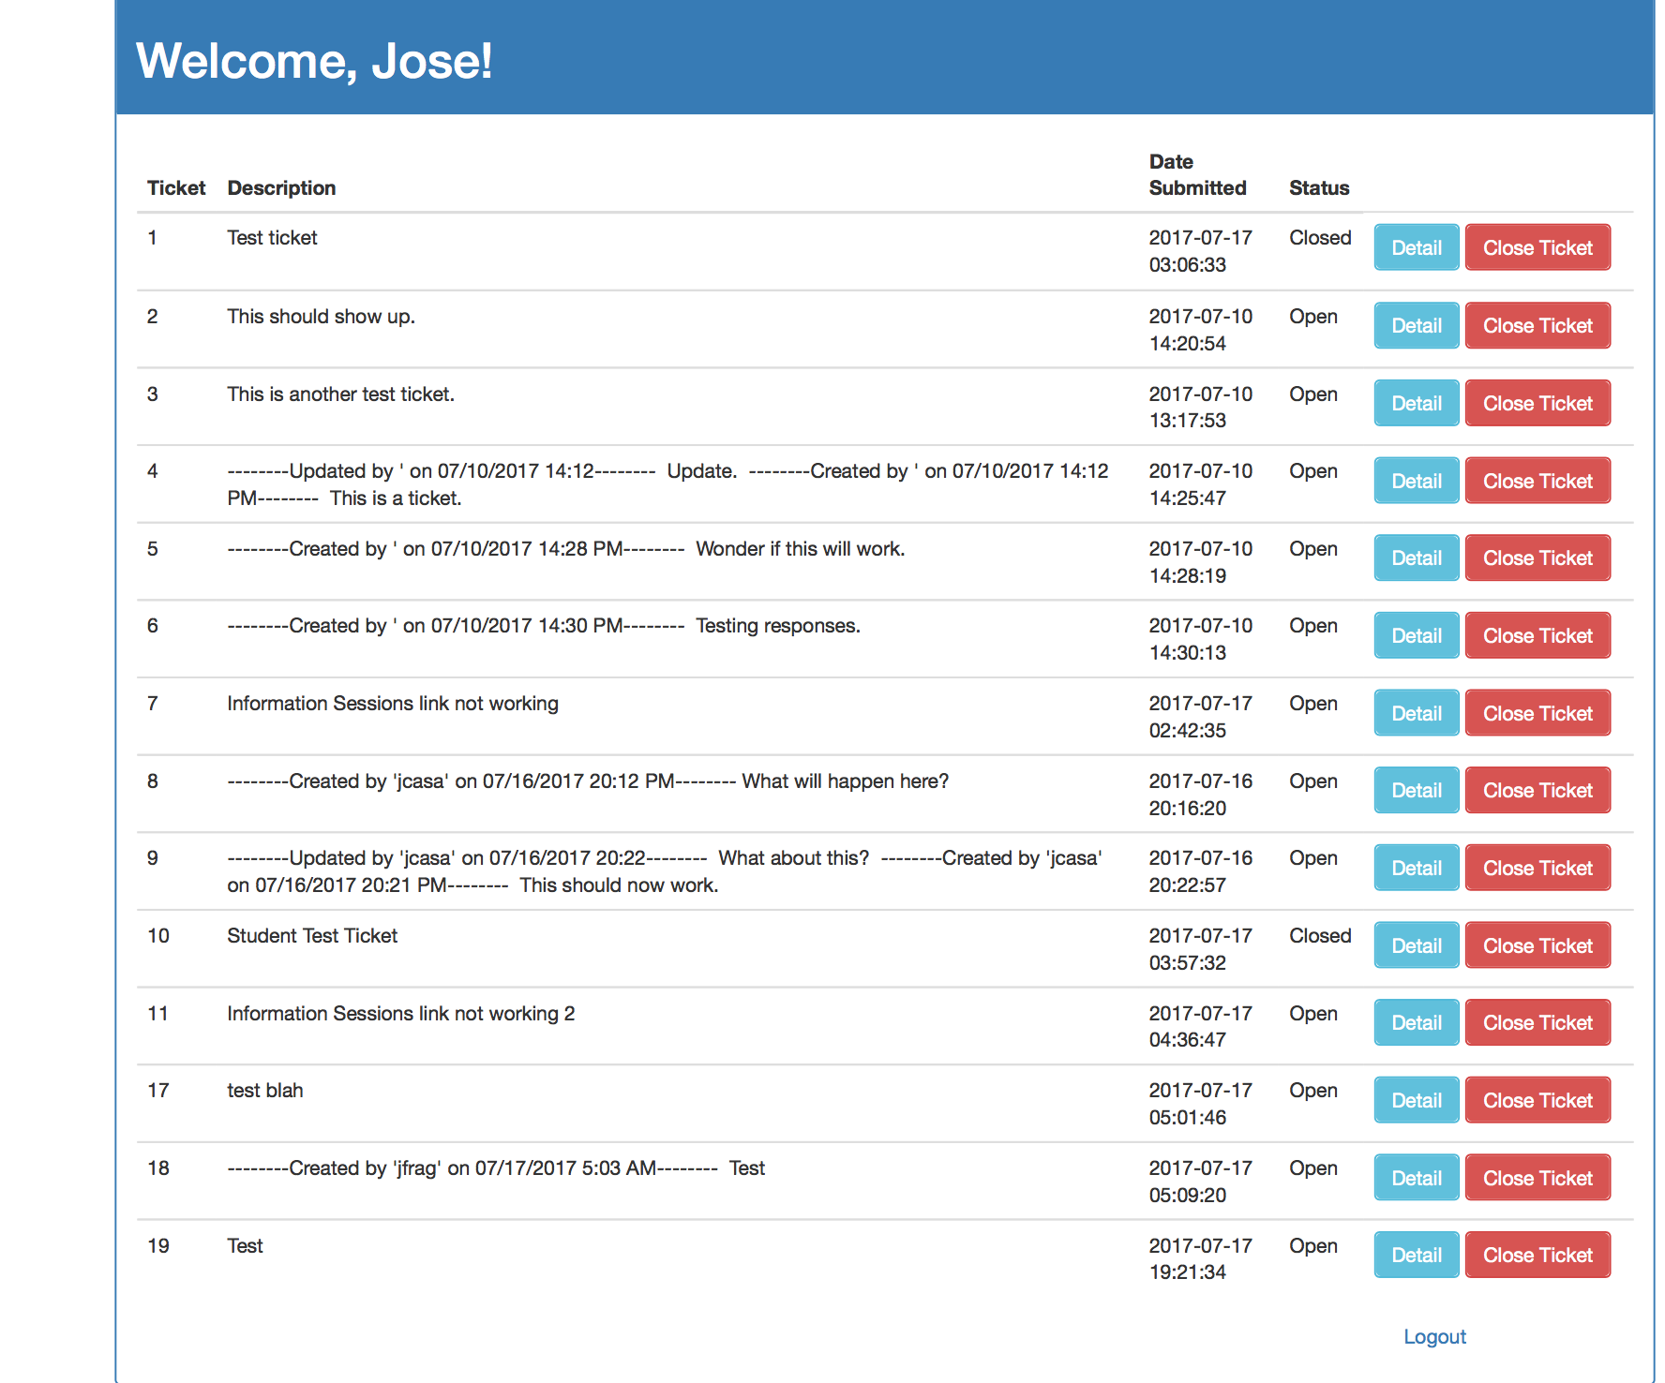
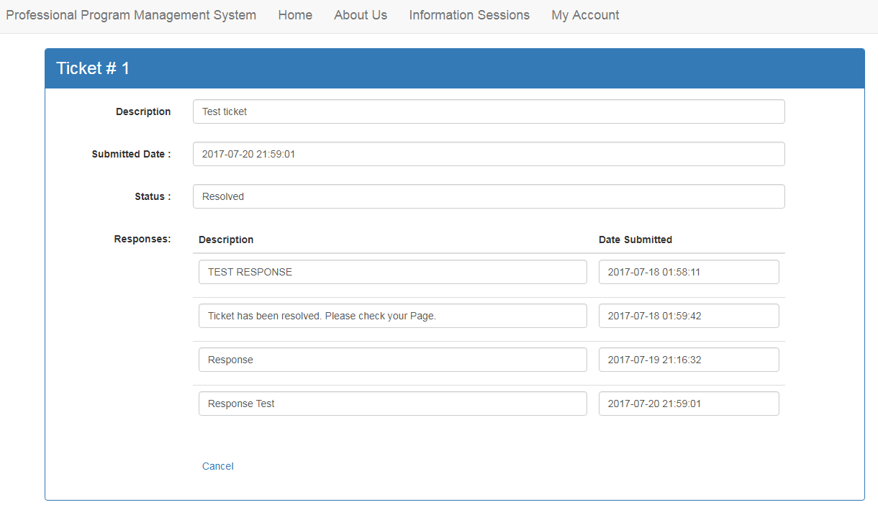
User Story #1
As a user of this management system who would like to be able to create a request or report an issue to all administrators of the system.
Notes:
20 seconds
The tile of user story
Please present and show the complexity of your work, code, algorithms, and technical challenges and technologies you have used. (you could use screenshot if you want. Visual presentations are better than text presentation) - Go into the details of the most important/significant tasks using bullet lists or visual graphs or state chart diagram - Demo using screenshots or GIF (in another separate page if required)
Sequence Diagram for this user story is optional

Slide 9
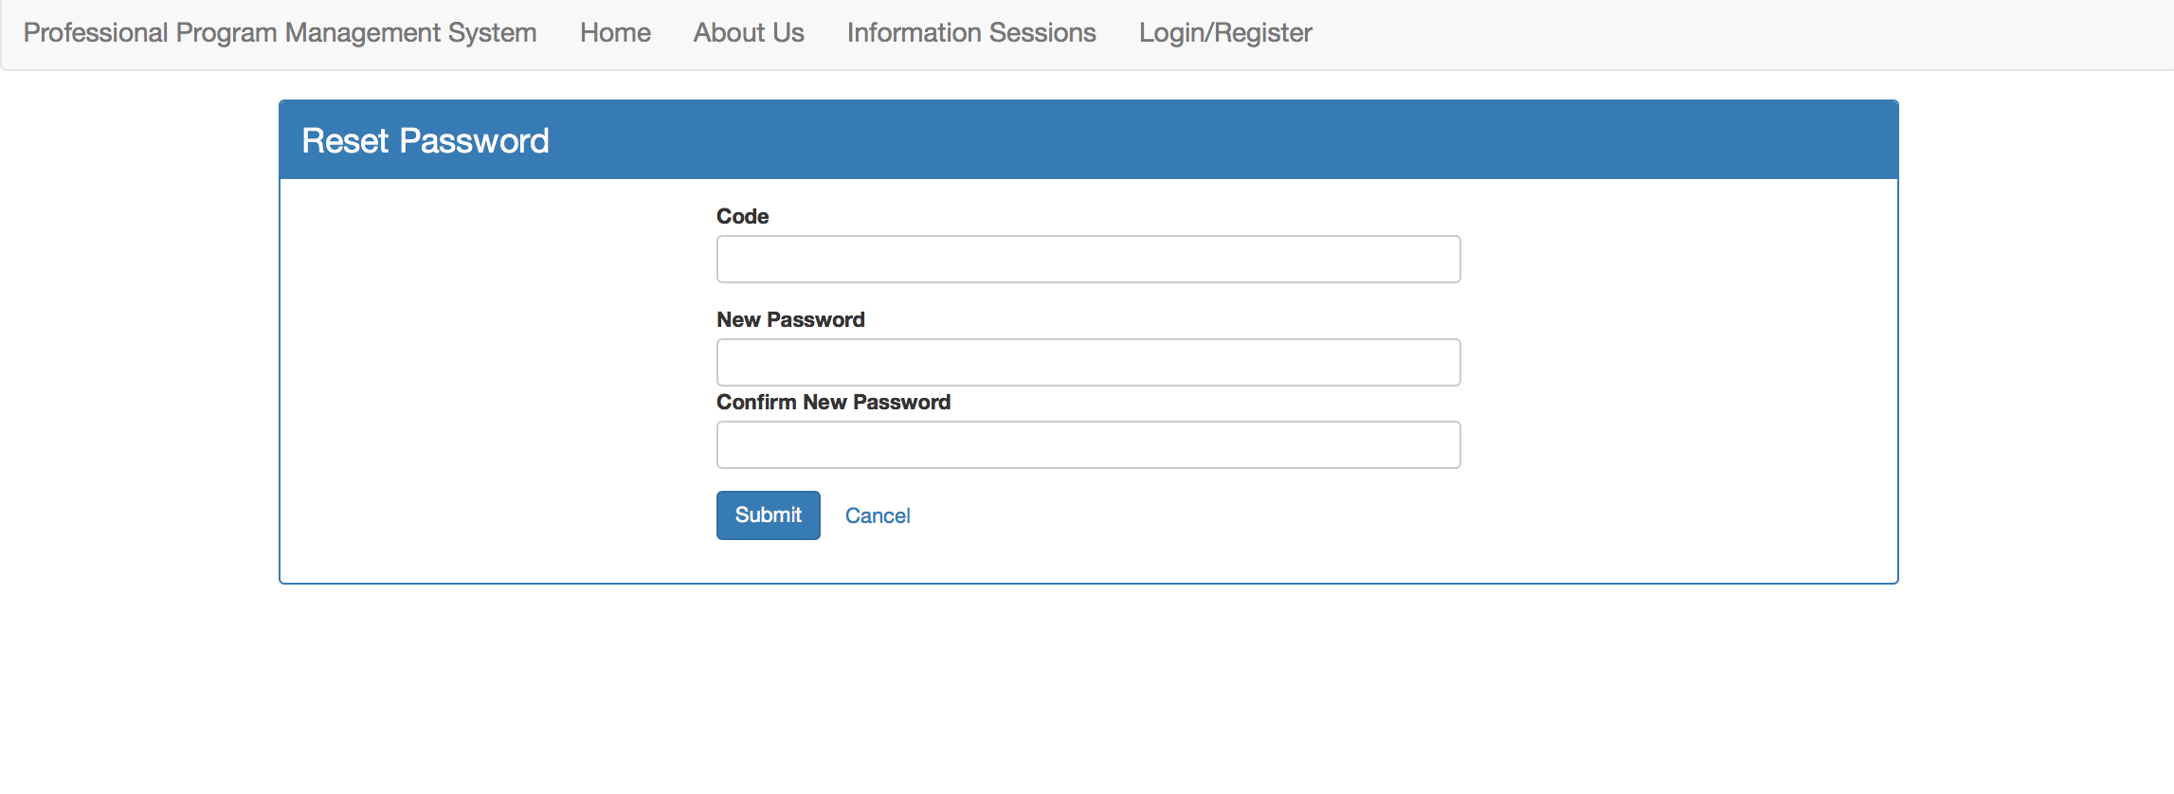
User Story #2
As a user of this management system who has forgotten my password and would like a way to have it reset.
Notes:
20 seconds
The tile of user story
Please present and show the complexity of your work, code, algorithms, and technical challenges and technologies you have used. (you could use screenshot if you want. Visual presentations are better than text presentation) - Go into the details of the most important/significant tasks using bullet lists or visual graphs or state chart diagram - Demo using screenshots or GIF (in another separate page if required)
Sequence Diagram for this user story is optional

Slide 10
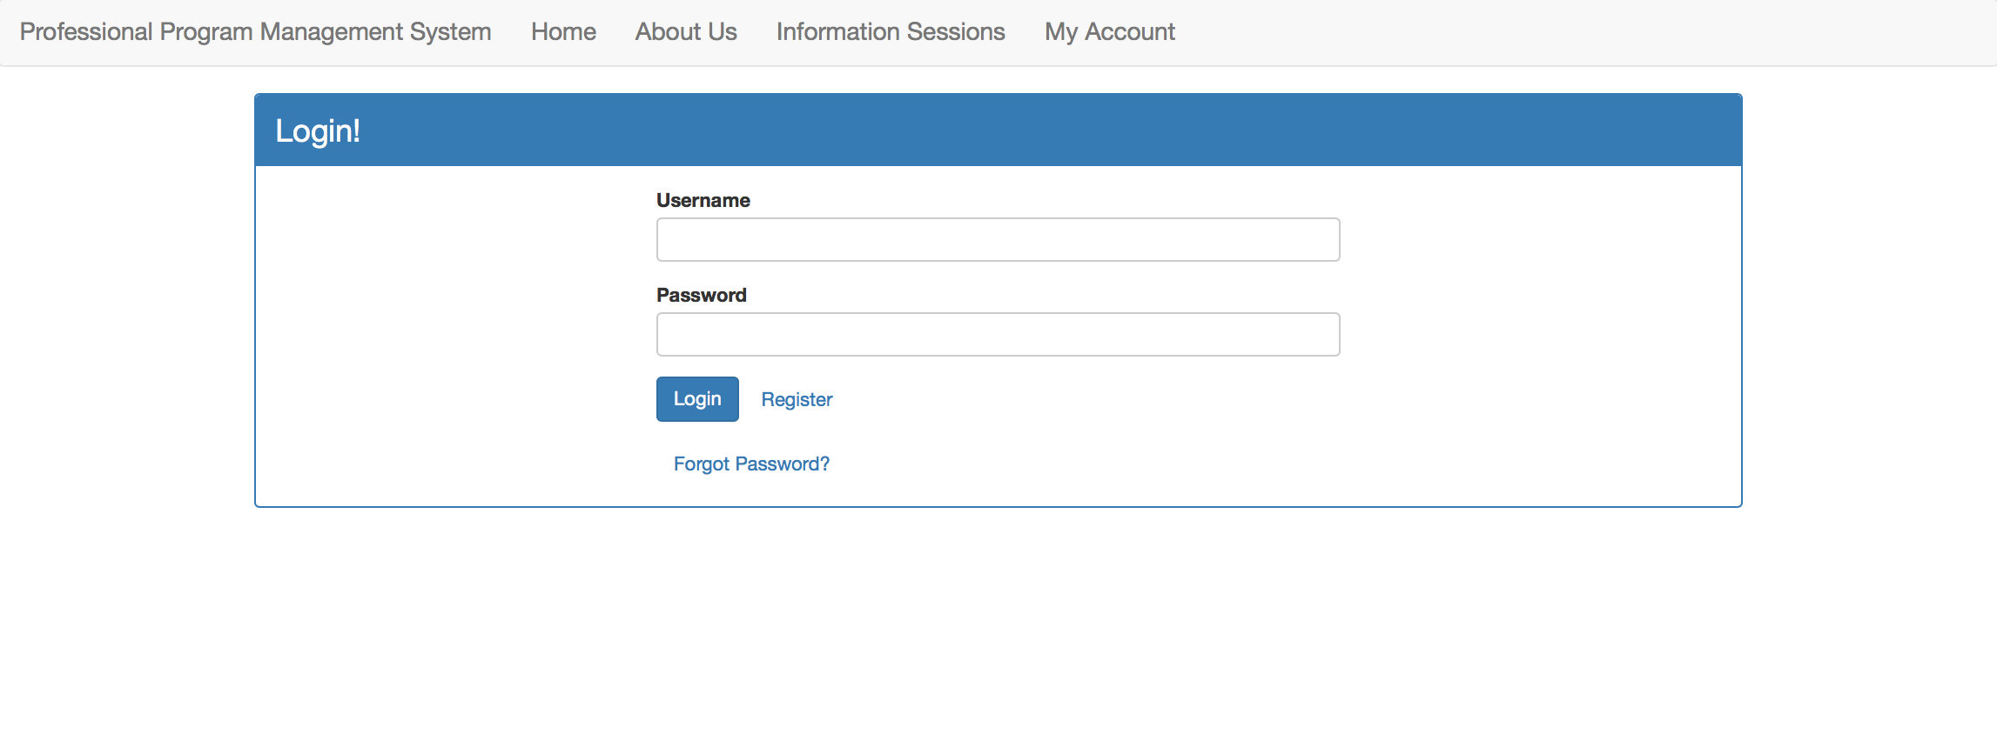
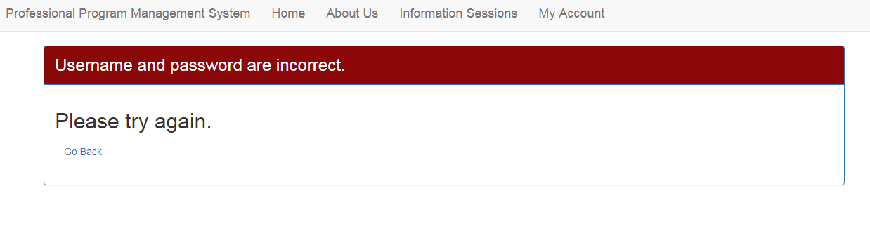
User Story #3
As a new user of this program who would like to be able to log into my account so that I might access the management system’s features.
Notes:
20 seconds
The tile of user story
Please present and show the complexity of your work, code, algorithms, and technical challenges and technologies you have used. (you could use screenshot if you want. Visual presentations are better than text presentation) - Go into the details of the most important/significant tasks using bullet lists or visual graphs or state chart diagram - Demo using screenshots or GIF (in another separate page if required)
Sequence Diagram for this user story is optional

Slide 11
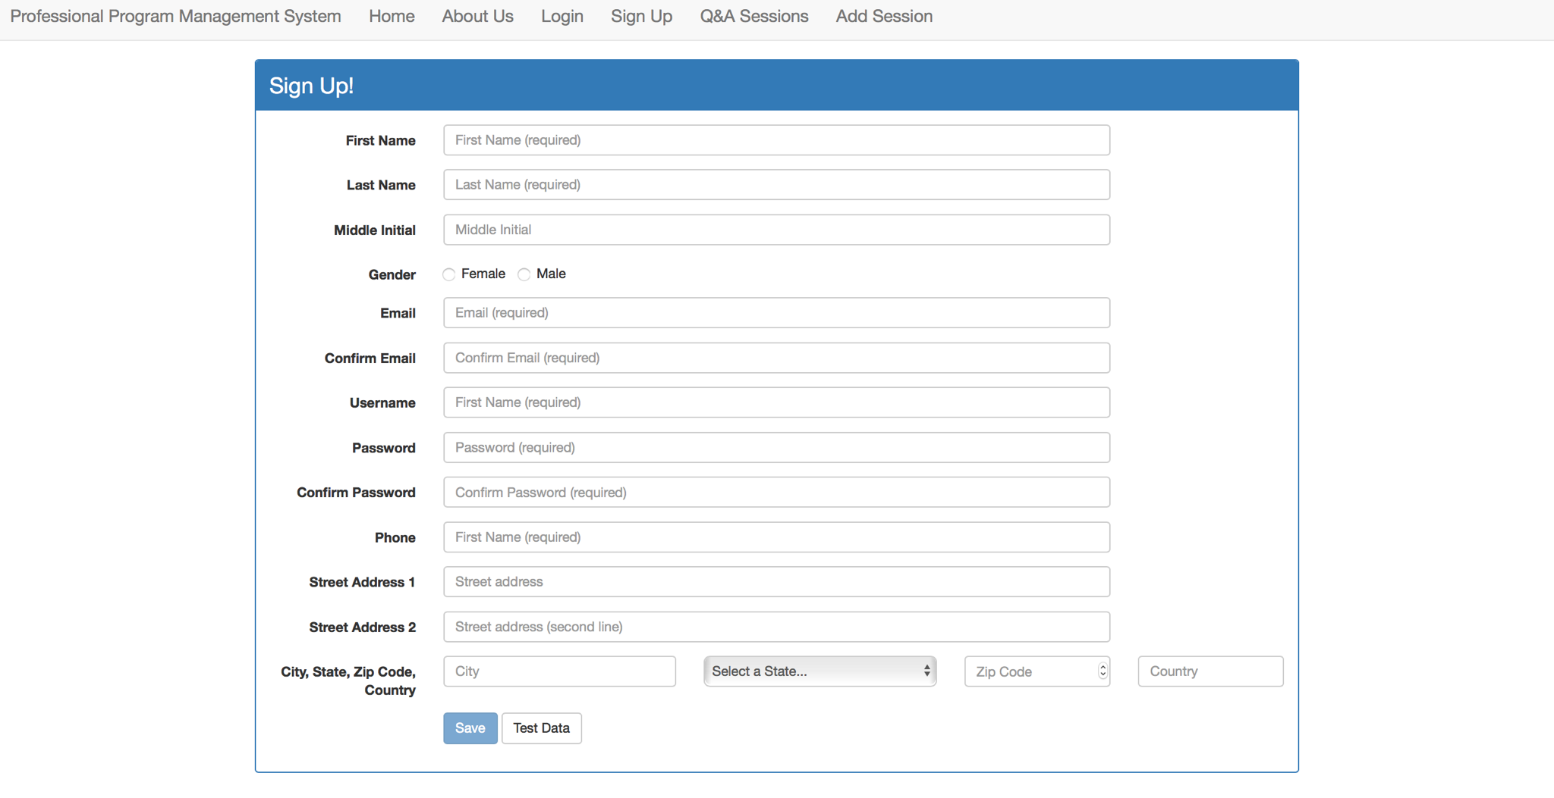
User Story #1
As someone interested in this professional program and would like to be able to create an account so that I may learn more about it.
Notes:
60 seconds
The tile of user story
The most important user story you worked on it. You have to describe this one very well and be proud of that.
Please present and show the complexity of your work, code, algorithms, and technical challenges and technologies you have used. (you could use screenshot if you want. Visual presentations are better than text presentation)
Go into the details of the most important/significant tasks using bullet lists or visual graphs or state chart diagram
Sequence Diagram for this user story is mandatory (in another separate page if required)
Demo using screenshots or GIF (in another separate page if required)

Slide 12
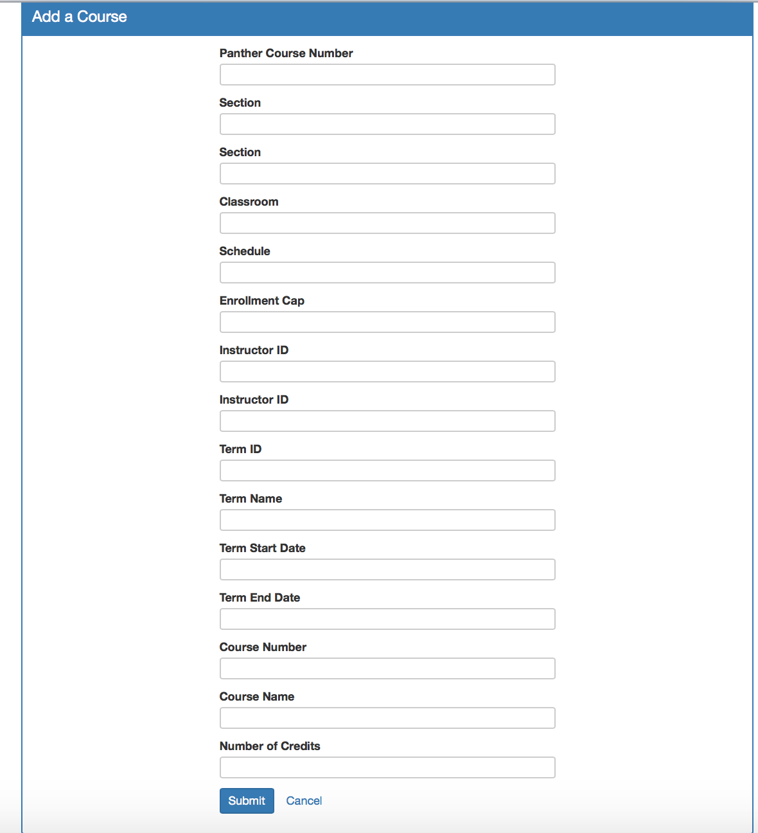
User Story #5
As a student of this management system who would like to be able to view all classes this program has to offer.
Only Administrator have to option to add new courses.
Notes:
20 seconds
The tile of user story
Please present and show the complexity of your work, code, algorithms, and technical challenges and technologies you have used. (you could use screenshot if you want. Visual presentations are better than text presentation) - Go into the details of the most important/significant tasks using bullet lists or visual graphs or state chart diagram - Demo using screenshots or GIF (in another separate page if required)
Sequence Diagram for this user story is optional

Slide 13
Test Suites and Test Cases
Description/Summary of Test: Admin shall be able to successfully change ticket status or reply to a Ticket
Pre-conditions: Admin needs internet access, navigate to the Home Page and login with a valid username and password. Admin clicks on “All Tickets”. After that Admin clicks on the ticket number. The ticket details should be displayed, then admin can edit the ticket (cancel or resolved), or can reply to the ticket.
Expected Results: Admin shall be able to successfully change ticket status or reply to a Ticket. Actual Result: Admin is able to successfully change ticket status or reply to a Ticket.
Notes:
10 seconds
A description of verification process and Test Suites and Test Cases for one of the use cases.
1 One sunny day and one rainy day for the implemented use cases (one or more slides).
2 Automated test scripts for the implemented use cases (if any) (one or more slides).

Slide 14





Summary
The Professional Program Management System was an intriguing project to work on leading to a better understanding of the software design process.
Contact Information:
Jose Casanova - jcasanova90@gmail.com
Joana Fraga - jfrag019@fiu.edu
Questions?
Notes:
10 seconds
Summarize your contribution, mention your effort for Scrum, Mingle, Github, Google Drive Documentation and minutes
Include your contact information
Ask if anyone has any questions for you.
Thank your audience

